Slide 1
Sydney Opera House
Environmental sustainability policy

Slide 2
Mission
We will treasure and renew the opera house for future generations of artists,audiences and visitors and everything we do will engage and inspire people through its excellence.

Slide 3
POLICIES
Set,communicate and deliver environmental sustainability objectives,targets and an implementation plan every 3 years.
Establish clear accountability
Monitor & assess performance against targets, benchmarks & standards

Slide 4
POLICIES continuation
Report on our performance publicly and transparently performance at upper management.
Communicate our commitments to staff and stakeholders.
Establish practices to achieve the requirements of environmental legislation,government policies and industry standards.

Slide 5
Responsibility of staff in achieving targets.
Staff who are independent contract managerd have responsibility of ensuring that the independent contractors are aware of & support Sydney house environmental sustainable policy.
To be aware of workplace healthy and safety policies and ensure the procedures are followed.

Slide 6
Continuation.
Participating in the training seminars,workshops that the Sydney opera house has instituted.
Participate in the group-wide employee opnion survey conducted in the organization.
The survey provide them with and opportunity to reflect the problems.

Slide 7
Activities that the staff are to carry out.
Maintaining air conditioning at the constant temperatures.
Switching of the lights,when not in use by anyone.
Proper disposal of waste in the designated places in the Sydney opera house.
Participating in brainstorming activities in their own departments geared towards environmental sustainability.

Slide 8
Expected outcome
Conservation of natural resource,reduced waste and pollution generated by Sydney opera house.
Being a leader in environmental and social sustainability in line with the opera house status as a symbol of modern Australia.
Staff, partners and community fully involved in the company environmental sustainability plan.
Carrying out sustainable procurement.

Slide 9
A procedural way of achieving sustainability plans
Identification of the targets.
Detailed comprehension of the targets.
Subdivision of the targets into achievable portions.
Having a suitable metric for measurement
Application of corrective measures in the case of deviation.
Regular review and updating of the sustainability policy inline with global changes

Slide 10
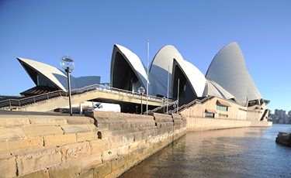
THANK YOU.

